Slide 1
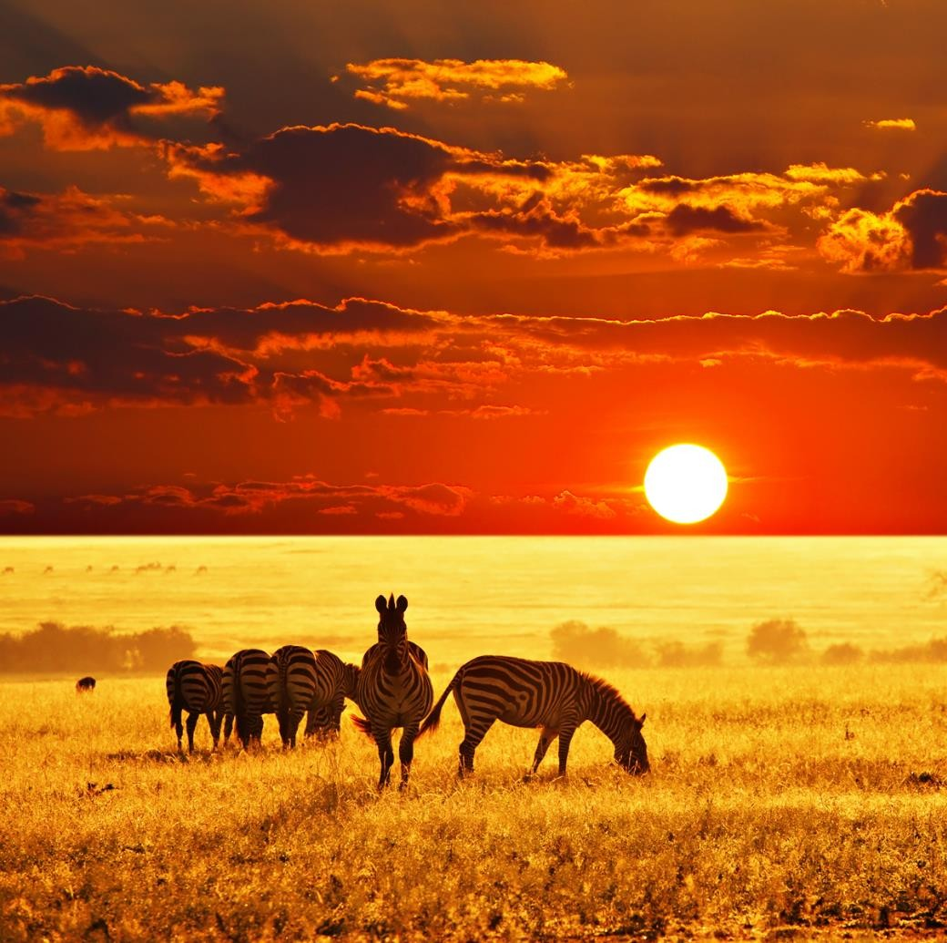
“African Savana Grounds “
SCRUTINIZING
A Far Cry from Africa – Derek Walcott
ANDREW EUGENE
ANALYSIS

Slide 2
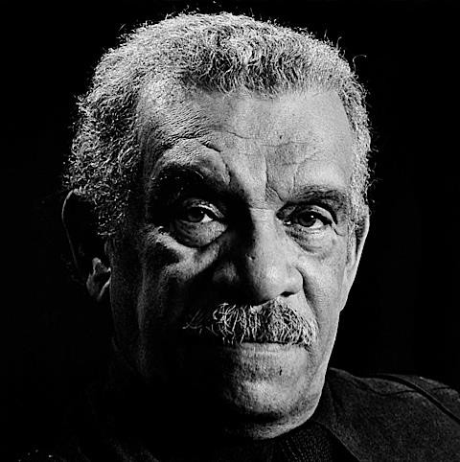
THE POET
D
erek Alton Walcott, OBE OCC (born 23 January 1930) is a Saint Lucian poet and playwright. He received the 1992 Nobel Prize in Literature. He is
currently Professor of poetry at the University of Essex. His works include the Homeric epic poem, Omeros (1990), which many critics view "as Walcott's major achievement." In addition to having won the Nobel, Walcott has won many literary awards over the course of his career including an Obie Award in 1971 for his play Dream on Monkey Mountain, a MacArthur Foundation "genius" award, a Royal Society of Literature Award, the Queen's Medal for Poetry, and the 2011 T. S. Eliot Prize for his book of poetry, White Egrets (Wikipedia)
♥ HIS WORK
POEMS
♥ 1948 25 Poems
♥ 1949 Epitaph for the Young: Xll Cantos
♥ 1951 Poems
♥ 1962 In a Green Night: Poems 1948—60
♥ 1964 Selected Poems
♥ 1965 The Castaway and Other Poems
♥ 1969 The Gulf and Other Poems
♥ 1973 Another Life
♥ 1976 Sea Grapes
♥ 1979 The Star-Apple Kingdom
♥ 1981 Selected Poetry
♥ 1981 The Fortunate Traveller
♥ 1983 The Caribbean Poetry of Derek Walcott and the Art of Romare Bearden
♥ 1984 Midsummer
♥ 1986 Collected Poems, 1948-1984, featuring Love After Love
♥ 1987 "Central America"
♥ 1987 The Arkansas Testament
♥ 1990 Omeros
♥ 1997 The Bounty
♥ 2000 Tiepolo's Hound, includes Walcott's watercolors
♥ 2004 The Prodigal
♥ 2007 Selected Poems (Edited, selected, and with an introduction by Edward Baugh)
♥ 2010 White Egrets

Slide 3
♥ 2014 The Poetry of Derek Walcott 1948-2013
PLAYS
♥ (1950) Henri Christophe: A Chronicle in Seven Scenes
♥ (1951) Harry Dernier: A Play for Radio Production
♥ (1953) Wine of the Country
♥ (1954) The Sea at Dauphin: A Play in One Act
♥ (1957) Ione
♥ (1958) Drums and Colours: An Epic Drama
♥ (1958) Ti-Jean and His Brothers
♥ (1966) Malcochon: or, Six in the Rain
♥ (1967) Dream on Monkey Mountain
♥ (1970) In a Fine Castle
♥ (1974) The Joker of Seville
♥ (1974) The Charlatan
♥ (1976) O Babylon!
♥ (1977) Remembrance
♥ (1978) Pantomime (Walcott play)
♥ (1980) The Joker of Seville and O Babylon!: Two Plays
♥ (1982) The Isle Is Full of Noises
♥ (1984) "The Haitian Earth"
♥ (1986) Three Plays The Last Carnival, Beef, No Chicken, and A Branch of the Blue Nile)
♥ (1991) Steel
♥ (1993) Odyssey: A Stage Version
♥ (1997) The Capeman (lyrics, in collaboration with Paul Simon)
♥ (2002) Walker and The Ghost Dance
♥ (2011) Moon-Child
♥ (2014) O Starry Starry Night
OTHER BOOKS
♥ (1950) Henri Christophe: A Chronicle in Seven Scenes , Barbados Advocate (Barbados)
♥ (1990) The Poet in the Theatre, Poetry Book Society (London)
♥ (1993) The Antilles: Fragments of Epic Memory Farrar, Straus (New York)
♥ (1996) Conversations with Derek Walcott, University of Mississippi (Jackson, MS)
♥ (1996) (With Joseph Brodsky and Seamus Heaney) Homage to Robert Frost, Farrar, Straus (New York)
♥ (1998) What the Twilight Says (essays), Farrar, Straus (New York, NY)
♥ (2002) Walker and Ghost Dance, Farrar, Straus (New York, NY)
♥ (2004) Another Life: Fully Annotated, Lynne Rienner Publishers (Boulder, CO) (WIKIPEDIA)

Slide 4
THE POEM
+ GLOSSARY (LINES 239 – 264)
Tawny is a colour, like a yellowish-brown. a pelt is an animal
Group of Bantu people inhabiting Southeast Africa
A wind is ruffling the tawny pelt
Of Africa. Kikuyu, quick as flies,
open, uncultivated country or grassland in southern Africa
Batten upon the bloodstreams of the veldt.
flesh, meat
Corpses are scattered through a paradise.
Only the worm, colonel of carrion, cries:
“Waste no compassion on these separate dead!”
Statistics justify and scholars seize
an outward bulge in a line of military attack or defence.
The salients of colonial policy.
Sliced
What is that to the white child hacked in bed?
To savages, expendable as Jews?
Threshed out by beaters, the long rushes break
a large wading bird with a long down-curved bill, long neck, and long legs.
In a white dust of ibises whose cries
Dry, arid, scorched
Have wheeled since civilization’s dawn
From the parched river or beast-teeming plain.
The violence of beast on beast is read
As natural law, but upright man Seeks his divinity by inflicting pain.
Delirious as these worried beasts, his wars
Dance to the tightened carcass of a drum, While he calls courage still that native dread
Holiness, spirituality
Wrecking, perpetrating
Of the white peace contracted by the dead.
Employed, committed
Again brutish necessity wipes its hands
Upon the napkin of a dirty cause, again A waste of our compassion, as with Spain,
The gorilla wrestles with the superman.

Slide 5
I who am poisoned with the blood of both,
Where shall I turn, divided to the vein?
I who have cursed
The drunken officer of British rule, how choose Between this Africa and the English tongue I love? Betray them both, or give back what they give?
How can I face such slaughter and be cool?
How can I turn from Africa and live?
Massacre, butchery
SCRUTINIZE IT
♥ TITLE & BACKGROUND
Ton the events of Mau-Mau uprising. Being a hybrid of both black and white, he comments
he title of this poem ‘A FAR CRY FROM AFRICA’ means a different story from Africa. Derek focuses
impartially on the savage massacre. The poem is filled with pain and craving for blood.
♥ SUMMARY
The poem is divided is divided into two. The first two stanzas focuses on the Kenyan conflict and the next two stanza refers to the poets own roles. The insider/outside role which has affected his feelings. The colonial policy says that killing children is prohibited but the black people has buried that rule below their feet. “What is to the white child hacked in bed”? Dead bodies of the white are scattered throughout the place like ibises eggs thrashed out by beaters. Ibises eggs are metaphors for white children. The beaters are the Africans.
Then Derek leaps into the topic where he says he can’t choose who’s right and wrong. “The gorilla wrestles with the superman”. This is a metaphorical sentence where the gorilla means the black people and superman, the white. He claims to be poisoned by the blood of both and he has no option to select. He questions how to choose between two by betraying one. Should I do what they do? – He questions. He loves the African culture and country but adores the English language meanwhile. He has no options but bear what happens because he’s ahybrid.

Slide 6
♥ POSSIBLE THEMES
IRRATIONALITY OF PEOPLE
CULTURAL VIOLENCE
SCRUTINIZING by Andrew Eugene is licensed under a Creative Commons Attribution-NonCommercial- NoDerivatives 4.0 International License.
Based on a work at http://www.scribd.com/AndrewEugene.

